Slide 1
Data Modeling Using the (ER) Model
Dr. Ibrahim Abdel Moniem

Slide 2
Unified Modeling Language (UML) are becoming increasingly popular in both database and software design.
An important part of these methodologies—namely, class diagrams—is similar in many ways to the ER diagrams. In class diagrams, operations on objects are specified, in addition to specifying the database schema structure.
Operations can be used to specify the functional requirements during database design,

Slide 3
Using High-Level Conceptual Data Models for Database Design

Slide 4
A Sample Database Application
COMPANY database keeps track of a company’s employees, departments, and projects.
The company is organized into departments.
Each department has a unique name, a unique number, and a particular employee who manages the department.
A department controls a number of projects, each of which has a unique name, a unique number, and a single location.
The database will store each employee’s information,
The database will keep track of the dependents of each employee for insurance purposes

Slide 5
Entity Types, Entity Sets, Attributes, and Keys
The ER model describes data as entities, relationships, and attributes.
An entity is the basic concept that the ER model, which is a thing or object in the real world with an independent existence.
For example, a particular person, car, house, or employee.
Each entity has attributes—the particular properties that describe it.
For example, an EMPLOYEE entity may be described by the employee’s name, age, address, salary, and job.

Slide 7
Composite versus Simple (Atomic) Attributes.
Composite attributes can be divided into smaller subparts, which represent more basic attributes with independent meanings.
For example, the Address attribute of the EMPLOYEE entity.
Attributes that are not divisible are called simple or atomic attributes.

Slide 8
Single-Valued versus Multivalued Attributes.
attributes have a single value for a particular entity; such attributes are called single-valued.
For example, Age is a single-valued attribute of a person.
In some cases an attribute can have a set of values for the same entity
For instance, a Colors attribute for a car, or a College_degrees attribute for a person.

Slide 9
Stored versus Derived Attributes.
The Age attribute is hence called a derived attribute and is said to be derivable from the Birth_date attribute which is called a stored attribute.
NULL Values. In some cases, a particular entity may not have an applicable value for an attribute.
For example, a person with no college degree would have NULL for College_degrees.
NULL can also be used if we do not know the value of an attribute for a particular entity—
For example, if we do not know the home phone number of ‘John Smith’

Slide 10
Entity Types, Entity Sets, Keys, and Value Sets
Entity type defines a collection (or set) of entities that have the same attributes.
entity set or entity collection is the collection of all entities of a particular entity type in the database at any point in time.
EMPLOYEE refers to both a type of entity as well as the current collection of all employee entities in the database.

Slide 11
Key Attributes of an Entity Type.
An entity type usually has one or more attributes whose values are distinct for each individual entity in the entity set. Such an attribute is called a key attribute.
its values can be used to identify each entity uniquely.

Slide 12
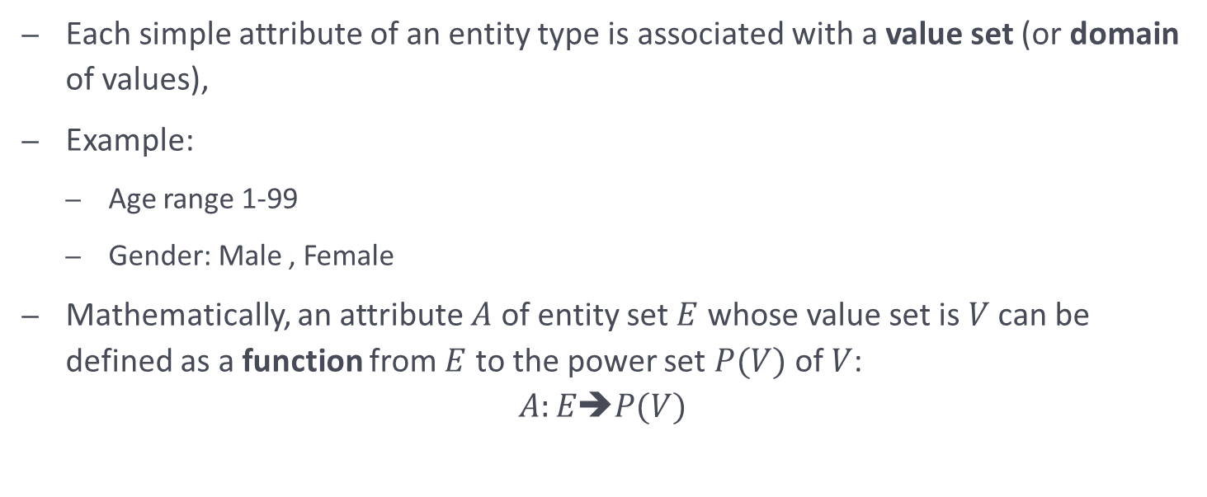
Value Sets (Domains) of Attributes.
Each simple attribute of an entity type is associated with a value set (or domain of values),
Example:
Age range 1-99
Gender: Male , Female
Mathematically, an attribute $A$ of entity set $E$ whose value set is $V$ can be defined as a function from $E$ to the power set $P(V)$ of $V$:
$$A:E➔P(V)$$

Slide 13
Initial Conceptual Design of the COMPANY Database

